Slide 1
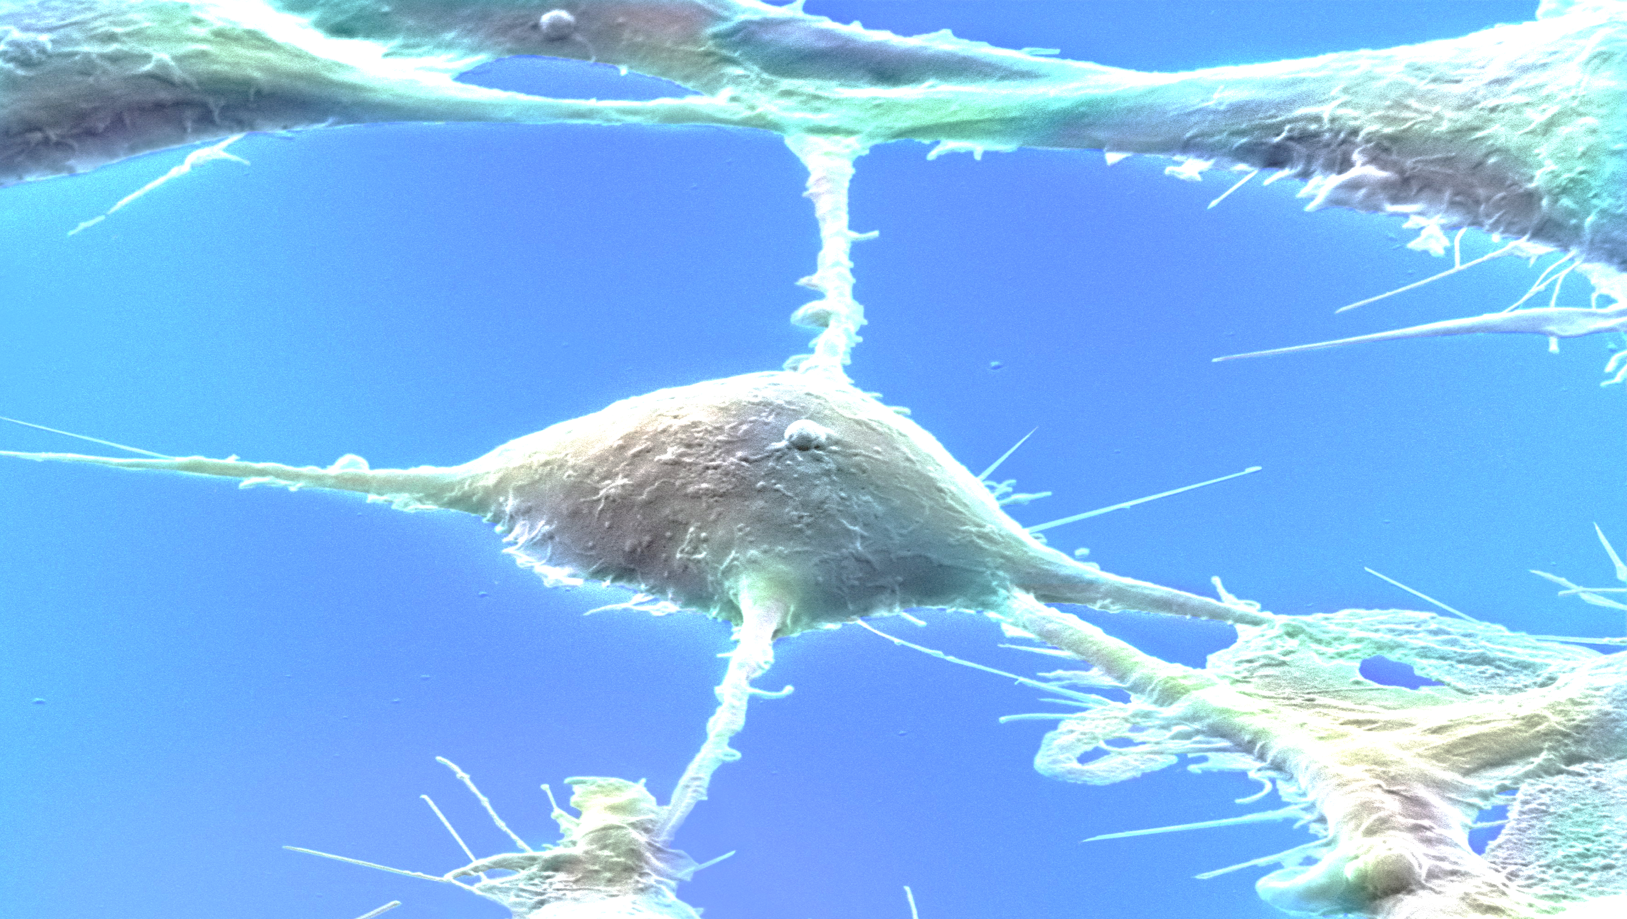
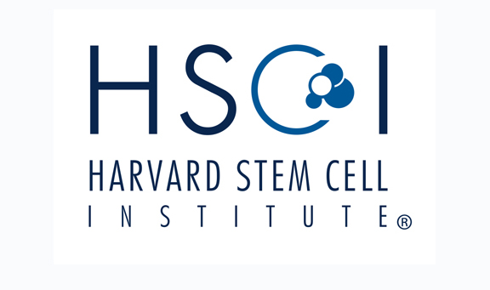
HSCI Skin Program
Special guest lecture
IOANNIS V. YANNAS, Ph.D.
MIT Professor of Polymer Science and Engineering
Why Mammals Fail
to Regenerate Their Organs
Friday, November 15, 2019 at 4:00 p.m.
Harvard Medical School | TMEC 209 | 260 Longwood
Refreshments served
Image credit: Wellcome Collection / CC BY

